Slide 1


A seminar
SASS
Submitted for Partial Fulfil for the Degree of:
BECHELOR OF COMPUTER APPLICATION [BCA]
[6th SEMESTER, TYBCA]
Year: 2020-2021
Submitted to:
M. K. INSTITUTE OF COMPUTER STUDIES BHARUCH

Slide 2
INTERNAL GUIDANCE:
MR. Paresh Prajapati
SUBMITTED BY:
SURENDRA RAWAT
ROLL NO:18B098
EXAM SEAT No: 1417

Slide 3
INDEX
sr no | topic | page no
1 | Introduction of topics | 5
2 | history | 6
3 | SASS Architecture | 7
3 | Working | 16
4 | Advantages/dis advantages | 17
5 | Installation | 24
6 | Conclusion | 37
7 | bibliography | 38

Slide 4
ACKNOWLEDGEMENTS
I take this opportunity to express our profound sense of gratitude and respect to all those who helped us throughout the duration of this seminar. Firstly, I am extremely grateful to M.K INSTITUTE OF COMPUTER STUDIES, BHARUCH, for providing the excellent working environment to undergo my seminar. I would like to devote our success in this effort to our Seminar guide MR. PARESH PRAJAPATI, for giving me the opportunity to undertake the project and providing crucial feedbacks that influenced us and provided opportunity to undertake the seminar work in the esteemed concern. I am deeply thankful to Prof. MR. PARESH PRAJAPATI, , whose useful suggestions, gentle soothing attitude and right directions helped us a lot to learn in this seminar and also for his constant encouragement and support throughout the project. Last, but not least I would like to extend my profound thanks to all our esteemed Colleagues and friends at college level who helped us in the specific areas of this Seminar. By: surendra rawat

Slide 5
INTRODUCTION OF SASS
Sass (short for syntactically awesome style sheets) is a pre-processor scripting language that is interpreted or compiled into Cascading Style Sheets (CSS). Sass Script is the scripting language itself.
Sass consists of two syntaxes. The original syntax, called "the indented syntax," uses a syntax similar to Html. It uses indentation to separate code blocks and newline characters to separate rules. The newer syntax, "SASS" (Sassy CSS), uses block formatting like that of CSS. It uses braces to denote code blocks and semicolons to separate rules within a block. The indented syntax and SASS files are traditionally given the extensions
The indented syntax is a metalanguage. SASS is a nested metalanguage, as valid CSS is valid SASS with the same semantics.
Sass Script provides the following mechanisms: variables, nesting, mixins, and selector inheritance.

Slide 6
History
Sass was designed by Hampton Catlin and developed by Natalie Weizenbaum.
After its initial versions, Weizenbaum and Chris Eppstein have continued to extend Sass with Sass Script, a scripting language used in Sass files.

Slide 7
SASS Architecture
Base
Layout
Abstracts
Components
Pages
Themes
Vendors

Slide 8
BASE
The base folder is something like a foundation style for the project, as the name says. Something serves throughout the project. This includes the base, reset, typography, normalize.
_base. Sass
_reset. Sass
_typography. Sass
_normalize. Sass

Slide 9
Layout
The layout folder contains the style for a website layout, simple as the name suggests. This folder includes stylesheet for the navbar, sidebar, footer, header, etc.
_navbar. Sass
_footer. Sass
_sidebar. Sass
_header. sass

Slide 10
Abstracts
The abstract folder is something different from other folders. Styles written in this folder do not compile to CSS. They are the helpers for other folders.
Two major SASS Abstracts are variables and mixins.
Variables are like a container that holds some value, later it can be used in other CSS property values. Later we can change the value of that variable so that the entire project gets updated with just one line of code.
Mixins are something that helps in reducing the effort of writing long codes or reusable codes. The best example would be media queries. They are really effective and easy to use.
_variables. Sass
_colours. sass
_mixins. Sass

Slide 11
Components
Components are a set of codes which has their character. It might be just one HTML element or a block of HTML elements.
Alert box, button, label, badge, list group, panel, modal are some of the common components we see on websites.
Apart from these common components, we can create our components. For example, Course card, info box, product card, success popup, profile card, and more.
_alert. Sass
_button. Sass
_badge. Sass
_label. Sass
_modal. Sass

Slide 12
Pages
The pages folder contains the style for targeting pages. It can be individual pages or a set of pages.
In my experience, I haven’t used this folder much apart from one e-commerce project. I had a few files in it, Login, Signup, Product, Product single, Blog, Blog single, and Invoice. Use this folder if it’s really required, if not just delete this folder, it is not something you have to use all the folder as the name says 7-1 SASS architecture. It’s all up to you on understanding it.
_product. Sass
_product-single. Sass
_blog. Sass
_blog-single. Sass
_invoice. Sass
_login. Sass
_signup. Sass

Slide 13
Themes
Theme’s folder is related to an overview of the project look. It could be Light theme, dark theme, blue theme, etc. This is also a folder used in very rare cases. Usually, this folder is used in template websites and open-source projects.
_dark-theme. Sass
_light-theme. Sass
_material-theme. Sass
_flat-theme. Sass

Slide 14
Vendors
All the external styles or 3rd party styles are placed in the Vendor folder. It could be libraries or frameworks. The most commonly used vendors are Bootstrap, Owl Carousel, jQuery UI, etc.
_bootstrap. Sass
_owl-carousel. Sass
_jQuery. sass

Slide 15
Working of sass
Small example on working of sass
$bgcolor: lightblue;
$textcolor: darkblue;
$fontsize: 18px;
/* Use the variables */
body {
background-color: $bgcolor;
color: $textcolor;
font-size: $fontsize;

Slide 16
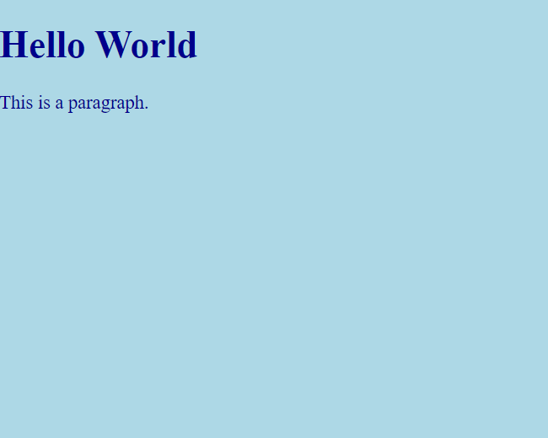
output

Slide 17
Advantages
Sass facilitates you to write clean, easy and less CSS in a programming construct.
It contains fewer codes so you can write CSS quicker.
It is more stable, powerful, and elegant because it is an extension of CSS. So, it is easy for designers and developers to work more efficiently and quickly.
It allows writing clean CSS in a programming construct.
It helps in writing CSS quickly.
It is a superset of CSS, which helps designers and developers work more efficiently and quickly.
As Sass is compatible with all versions of CSS, we can use any available CSS libraries.

Slide 18
Disadvantages
The developer must have enough time to learn new features present in this pre-processor before using it.
Using Sass may cause of losing benefits of browser's built-in element inspector.
It takes time for a developer to learn new features present in this pre-processor.
If many people are working on the same site, then should use the same pre-processor. Some people use Sass and some people use CSS to edit the files directly. Therefore, it becomes difficult to work on the site.
There are chances of losing benefits of browser's built-in element inspector.

Slide 19
Structure of sass
Just like CSS, most Sass stylesheets are mainly made up of style rules that contain property declarations. But Sass stylesheets have many more features that can exist alongside these.

Slide 20
Why to Use SASS?
It is a pre-processing language which provides indented syntax (its own syntax) for CSS.
It provides some features, which are used for creating stylesheets that allows writing code more efficiently and is easy to maintain.
It is a super set of CSS, which means it contains all the features of CSS and is an open source pre-processor, coded in Ruby.
It provides the document style in a good, structured format than flat CSS.
It uses re-usable methods, logic statements and some of the built-in functions such as color manipulation, mathematics and parameter lists.

Slide 21
Features of SASS
It is more stable, powerful, and compatible with versions of CSS.
It is a super set of CSS and is based on JavaScript.
It is known as syntactic sugar for CSS, which means it makes easier way for user to read or express the things more clearly.
It uses its own syntax and compiles to readable CSS.
You can easily write CSS in less code within less time.
It is an opensource pre-processor, which is interpreted into CSS.

Slide 22
Simple
Easy to use
Open source
Need few code
Compatible with any CSS
Re-Usability
Simple

Slide 23
System Requirements for SASS
Operating System − Cross-platform
Browser Support − IE (Internet Explorer 8+), Firefox, Google Chrome, Safari, Opera
Programming Language − Ruby

Slide 24
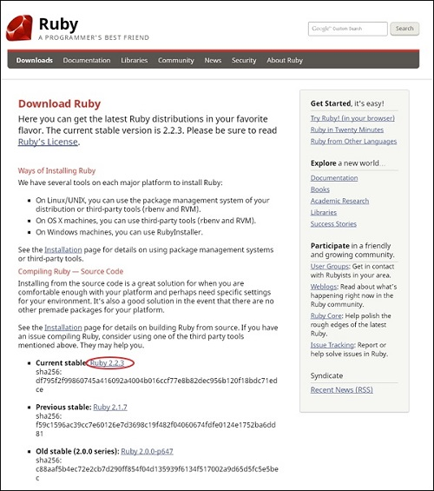
Installation of Ruby
Step 1 − Open the link https://www.ruby-lang.org/en/downloads/, you will see a screen as shown below

Slide 25
Step 2 − Next, run the setup to install Ruby on the System.
Step 3 − Next, add Ruby bin folder to your PATH User Variable and System Variable to work with gem command.
Path User Variable −
Right Click the My Computer icon.
Select Properties.
Next, click the Advanced tab and click Environment Variables.

Slide 26
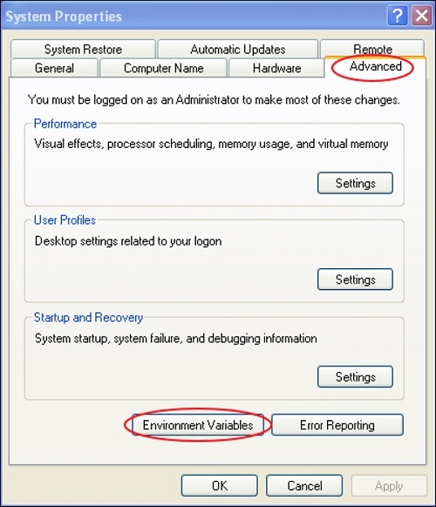

Slide 27
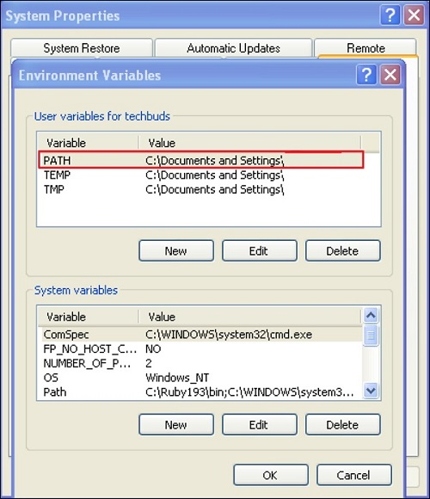
In the Environment Variables window, double click the PATH as shown in the screenshot given below

Slide 28
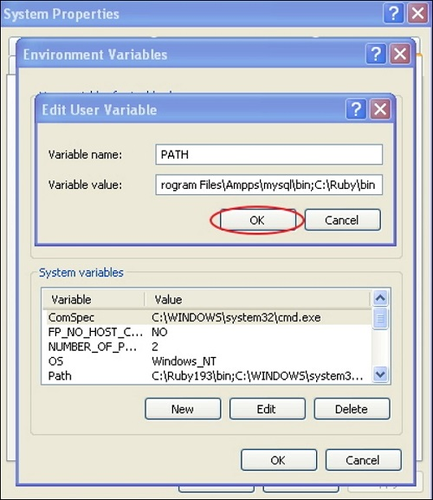
You will get an Edit User Variable box as shown. Add ruby bin folder path in the Variable value field as C:\Ruby\bin. If path is already set for other files, then put semicolon after that and add the Ruby folder path as shown below.

Slide 29
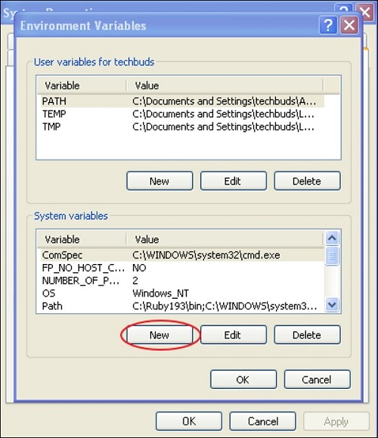
Click the OK button.
System Variable −
Click the New button.

Slide 30
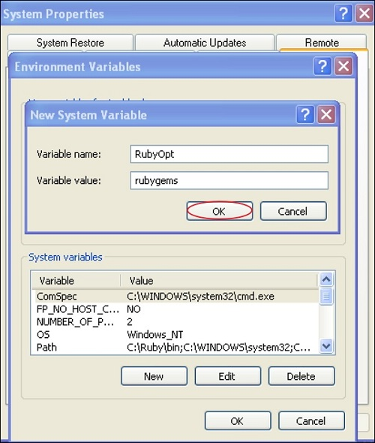
Next, the New System Variable block is displayed as shown below.

Slide 31
Enter RubyOpt in the Variable name field and ruby gems in the Variable value field. After writing the Variable name and value, click the OK button.
Step 4 − Open the command prompt in your system and enter the following line −
gem install sass
Step 5 − Next, you will see the following screen after installing SASS successfully.

Slide 32
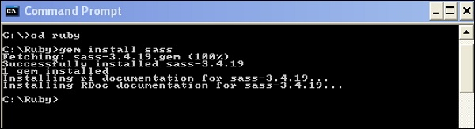

Slide 33
Example
<html>
<head>
<title> Import example of sass</title>
<link rel = "stylesheet" type = "text/css" href = "style.css"/>
</head>
<body>
<h1>Simple Example</h1>
<h3>Welcome to the gamming world</h3>
</body>
</html>

Slide 34
USAGE OF SASS
SASS is more powerful and stable that provides power to the basic language by using extension of CSS. You can use SASS in three different ways −
As a command line tool
As a Ruby module
As a plugin for Rack enable framework
If you are using SASS on windows, then you need to install Ruby first

Slide 35
Command & Description
sass input. Sass output.css It is used to run the SASS code from the command line.
sass --watch input. sass: output. CSS It informs SASS to watch the file and update the CSS whenever SASS file changes.
sass --watch app/sass: public/stylesheets It is used to watch the entire directory, if SASS contains many files in a directory.

Slide 36
Sass Comments.
Comments are non-executable statements, which are placed in source code. Comments make source code easier to understand.
SASS supports two types of comments.
Multiline comments − These are written using /* and */. Multiline comments are preserved in CSS output.
Single line comments − These are written using // followed by comments. Single line comments are not preserved in CSS output.

Slide 37
Conclusion
Sass accelerates you to write clean, easy, and few lines of the CSS code in a programming construct.
If you want to handle bigger projects in an organized way, then we recommend you use Sass in your project.
It can perform basic calculations, reuse code using mixins, and create functions.

Slide 38
bibliography
https://www.w3schools.com/sass/
https://www.tutorialspoint.com/sass/index.htm

Slide 39
THANK YOU

